Slide 1
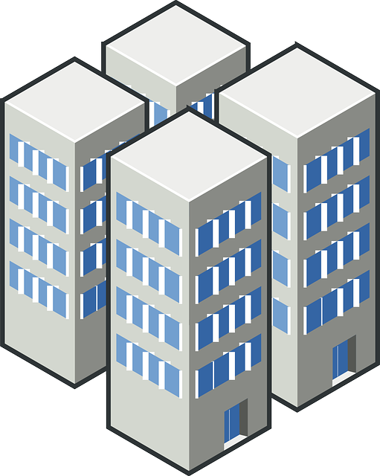
Toronto Apartment Prices
Seshagiri Sriram

Slide 2
Guiding Questions
Can we predict a Toronto apartment's rental price by knowing the businesses around it?
What makes one apartment more valuable than another with the same number of rooms?

Slide 3
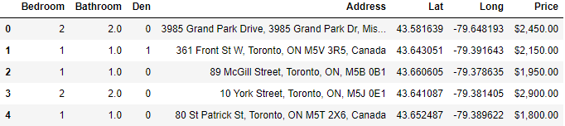
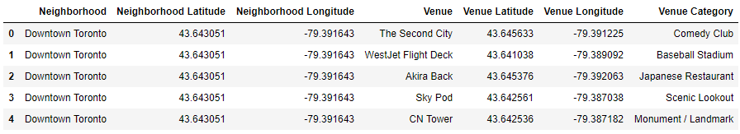
Data source
Toronto Apartment data from Kaggle
Nearby Venue data from Foursquare API

Slide 4
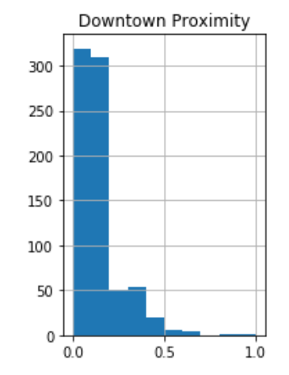
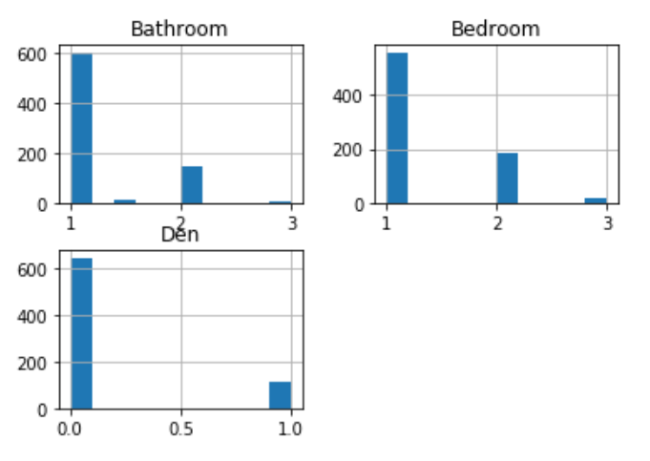
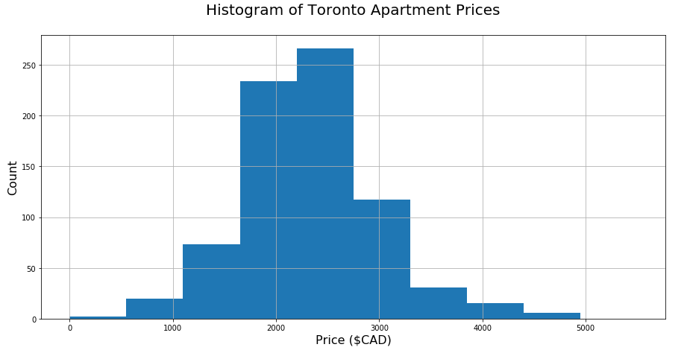
Exploring data from kaggle

Slide 5
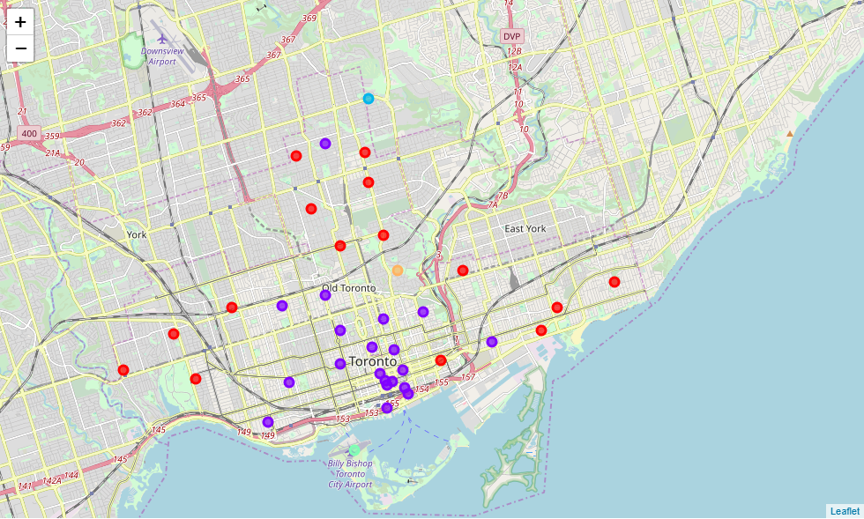
K-Means Clustering Toronto Neighbourhoods

Slide 6
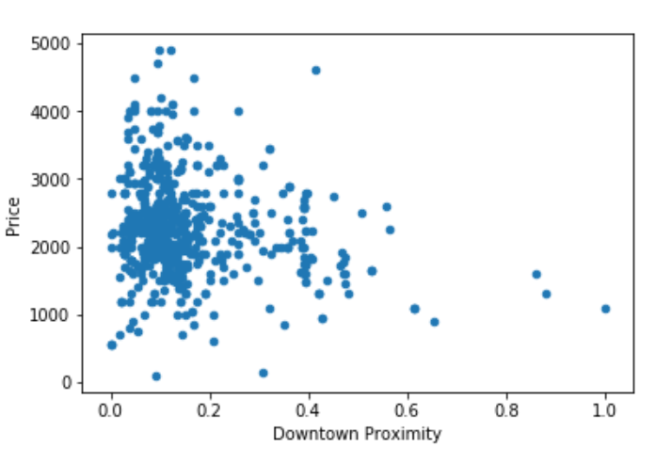
Downtown proximity vs. price
No or unclear linear trend
Very hard to differentiate data points close to downtown
Not a very good indicator of apartment price by itself.

Slide 7
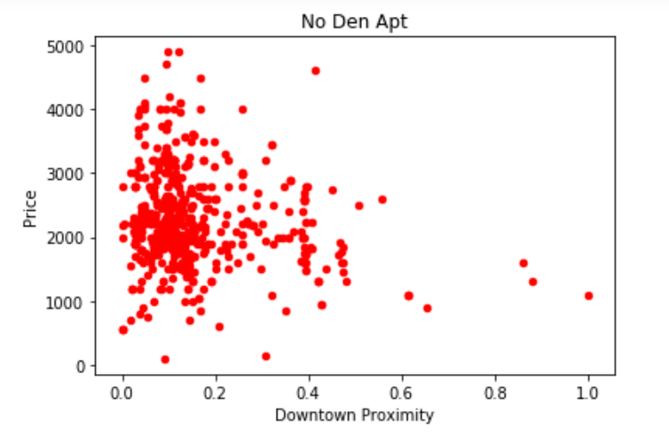
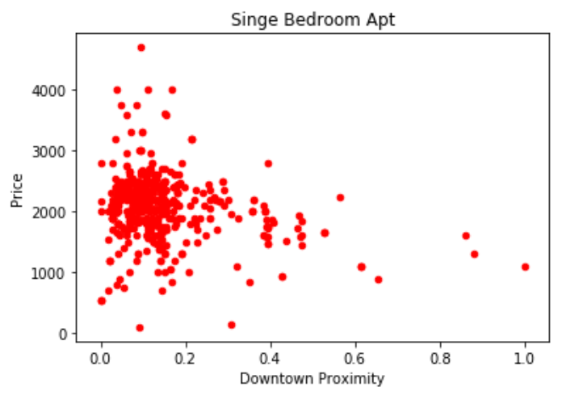
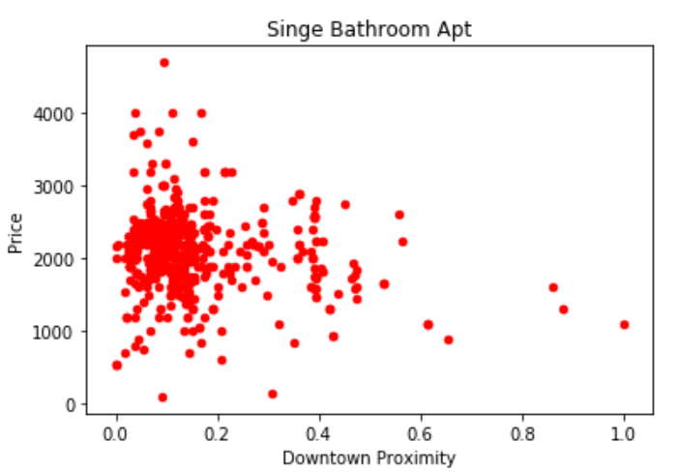
Room information vs price
Even introducing the number of bathrooms, bedrooms, and dens doesn’t give a clear trend in downtown Toronto Apartment price.
Need to introduce additional data to predict the price of an apartment in downtown Toronto
Use the nearby venues from the FourSquare API in addition to this data to try and predict the price

Slide 8
Benchmark machine learning models
Data is split 60/20/20 - 60% Train, 20% Test, 20% Validation
Feed nearby business and apartment information to different model.
Perform Hyperparameter tuning.
Evaluate models for Root Mean Square Error (RMSE) of price prediction in Canadian dollars (CAD)

Slide 9
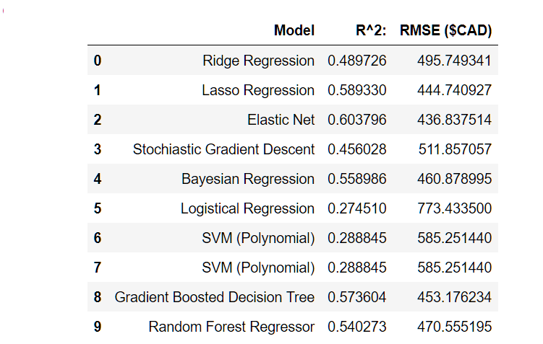
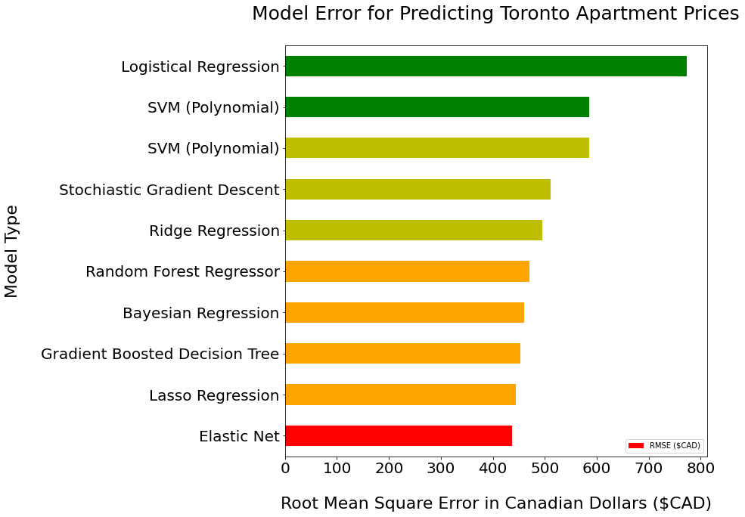
Initial Machine Learning results
Elastic Net model works best with lowest error and highest correlation

Slide 10
Perform model tuning
We tune the hyperparameters of the Elastic Net Model to perform better on the test set
After tuning we reduce its error on the test set predictions from $436 to $291.
$145 more accurate on average!

Slide 11
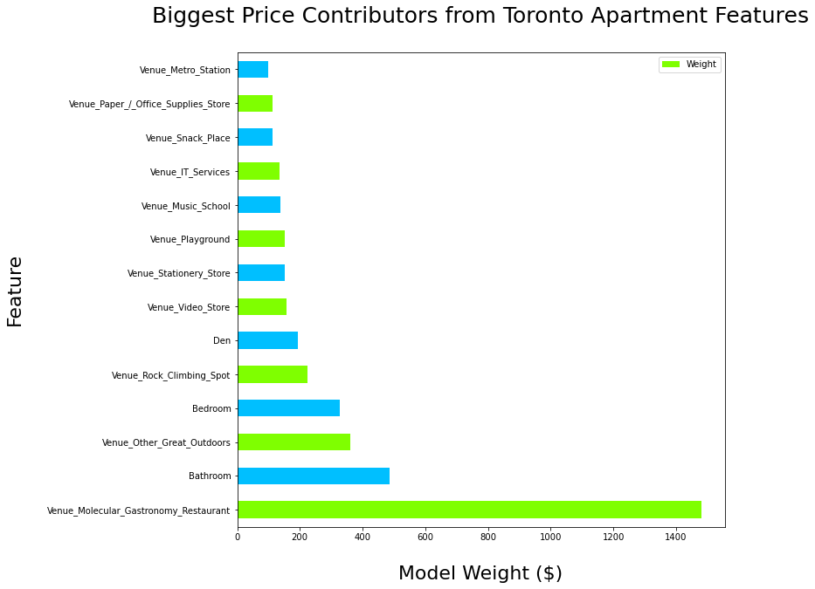
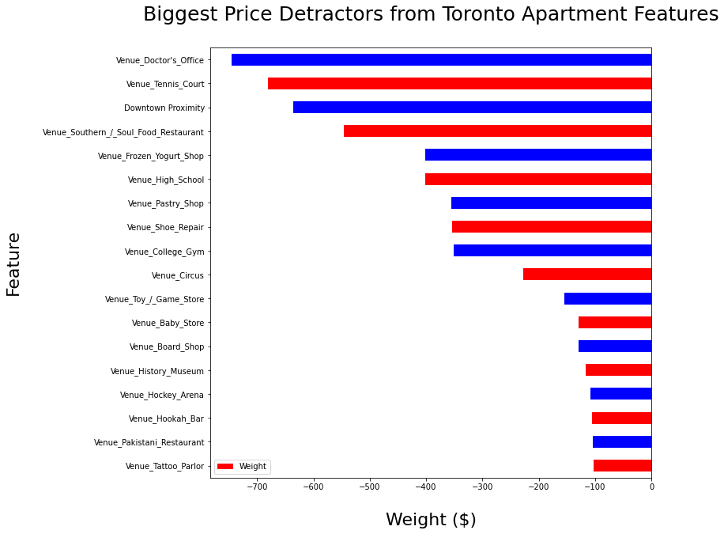
Extract features

Slide 12
Summary
More Expensive Apartments Have…
More Dens
More Bathrooms
More Bedrooms
Outdoors Activities Nearby: Parks, Golf, Playgrounds and Rock Climbing
Wine Stores
Closer to new age restaurants – Molecular Gastronomy
Cheaper Apartments Are…
Far from Downtown
High Schools, Toy Stores, Game Stores and Arcades Nearby
Tattoo Parlors and Hookah Bars
Ethnic restaurants

Slide 13
Recommendations based on results
For Apartment Building developers
- Develop apartments in neighborhoods with lots of parks, nature, outdoor activities, and as close to downtown as possible.
- Such units will have the highest price when these conditions are met and they are not surrounded by tattoo parlors, hookah bars and certain ethnic restaurants
- Such units will have the highest price when these conditions are met and they have wine parlors, new style food restaurants (molecular gastronomy), and are close to a doctor's office.

Slide 14
Recommendations based on results
For Apartment owners
Prices can be driven higher by investing in more green space, parks, playgrounds, and outdoor activities in the neighborhood.
For Tenants
Price will be lowest if you live further from downtown.
Look for apartments close to high schools, or without green space nearby, you can find apartments with a similar number of rooms for a lower rental price.

